Slide 1
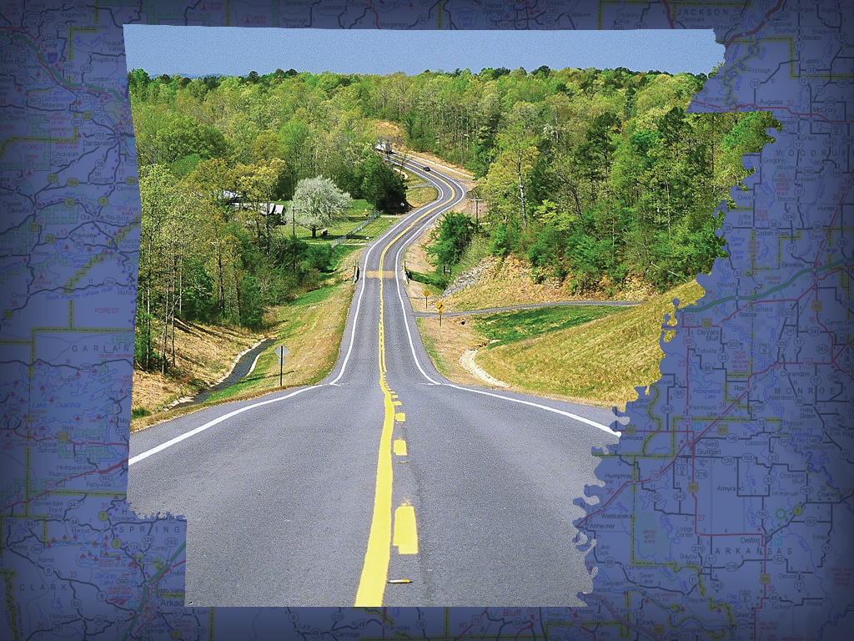

Environmental Justice 101
Karla Sims
Advanced Public Involvement Specialist
Environmental Division - Public Involvement

Slide 2

Learning Objectives
By the end of this session, participants will be able to:
Define Environmental Justice
Identify Environmental Justice communities
ARKANSAS DEPARTMENT OF TRANSPORTATION

Slide 3
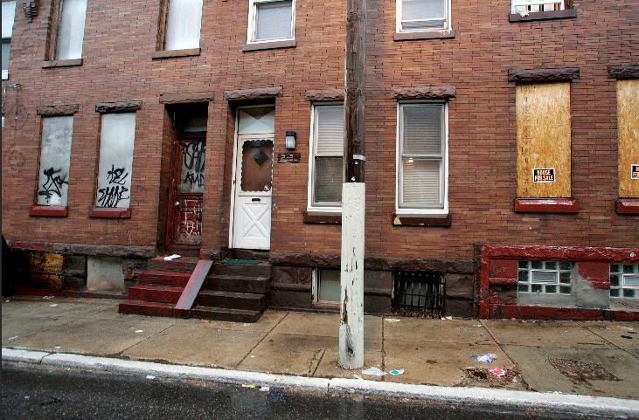
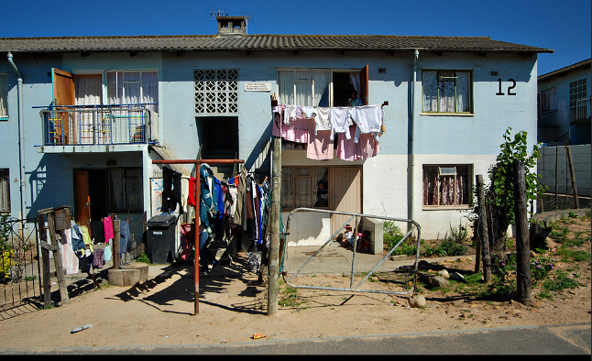
What is Environmental Justice?
Identifying and addressing disproportionately high and adverse effects of the agency's programs, policies, and activities on minority populations and low-income populations to achieve an equitable distribution of benefits and burdens.
Notes:
FHWA defines Environmental Justice as identifying and addressing disproportionately high and adverse effects of an agency's programs, policies, and activities on minority populations and low-income populations to achieve an equitable distribution of benefits and burdens.
Fair treatment means no group of people should bear a disproportionate share of the negative environmental consequences resulting from industrial, governmental and commercial operations or policies.
Meaningful involvement means: People have an opportunity to participate in decisions about activities that may affect their environment and/or health;
EJ is important because it helps to ensure full and fair participation of potentially affected communities in every phase of the transportation decision-making process.
When this is accomplished, the development, construction, operation and maintenance of transportation projects should reflect an equitable distribution of benefits and burdens.
The public's contribution can influence the regulatory agency's decision; Community concerns will be considered in the decision making process; and Decision makers will seek out and facilitate the involvement of those potentially affected.

Slide 4
Minority
Black (having origins in any of the black racial groups of Africa);
Hispanic or Latino (of Mexican, Puerto Rican, Cuban, Central or South American or other Spanish culture or origin, regardless of race);
Asian American (having origins in any of the original peoples of the Far East, Southeast Asia, the Indian subcontinent); or
American Indian and Alaska Native (having origins in any of the original people of North America and who maintains cultural identification through tribal affiliation or community recognition); or
Native Hawaiian and Other Pacific Islander (having origins in any of the original peoples of Hawaii, Guam, Samoa or Pacific Islands).
ARKANSAS DEPARTMENT OF TRANSPORTATION
Notes:
Defining the terms within the definition
The census and FHWA Order 6640.23A define Minority as: Black, Hispanic or Latino, Asian American, American Indian, Alaska Native, Native Hawaiian and Other Pacific Islanders .
These are considered immutable characteristic which are physical attributes that are perceived as being unchangeable.

Slide 5
Low-Income
Low-Income
  A household income at or below the Department of Health and Human Services poverty guidelines of $25,750 for a household of four (2019).
Low-Income Population
  Any readily Identifiable group of low-income persons who live in geographic proximity, and, if circumstances warrant, geographically dispersed/transient persons (such as migrant workers or Native Americans) who would be similarly affected by a proposed FHWA program, policy, or activity.
ARKANSAS DEPARTMENT OF TRANSPORTATION
Notes:
Low-Income is considered
A household income at or below the Department of Health and Human Services poverty guidelines of $25,750 for a household of four (2019).
The department of health and human services provides a poverty level for a household update annually.
For both terms “minority” and “low-income,” the U.S. DOT and FHWA EJ Orders define a “population” as any readily identifiable group of minority and/or low-income persons who live in geographic proximity, and, if circumstances warrant, geographically dispersed/transient persons of those groups (such as migrant workers, homeless persons, or Native Americans) who will be similarly affected by a proposed FHWA/DOT program, policy, or activity.

Slide 6
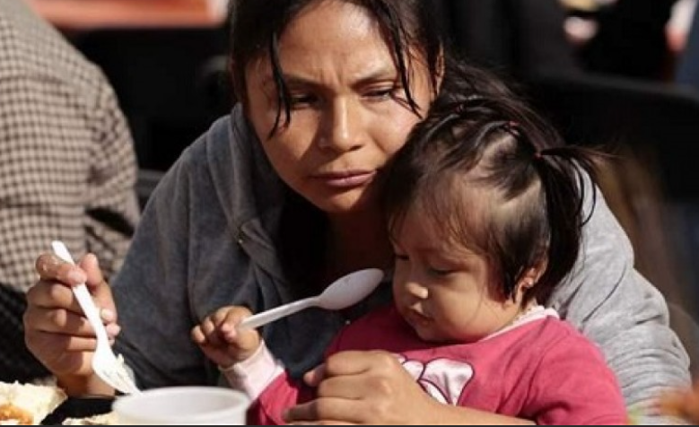

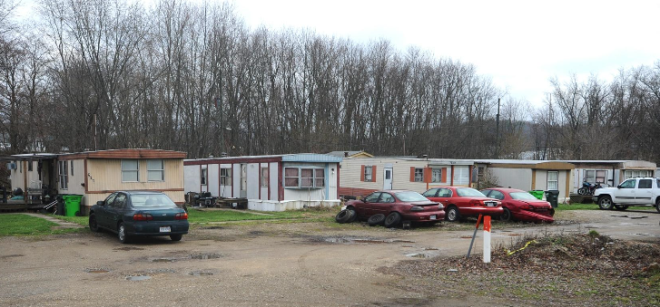
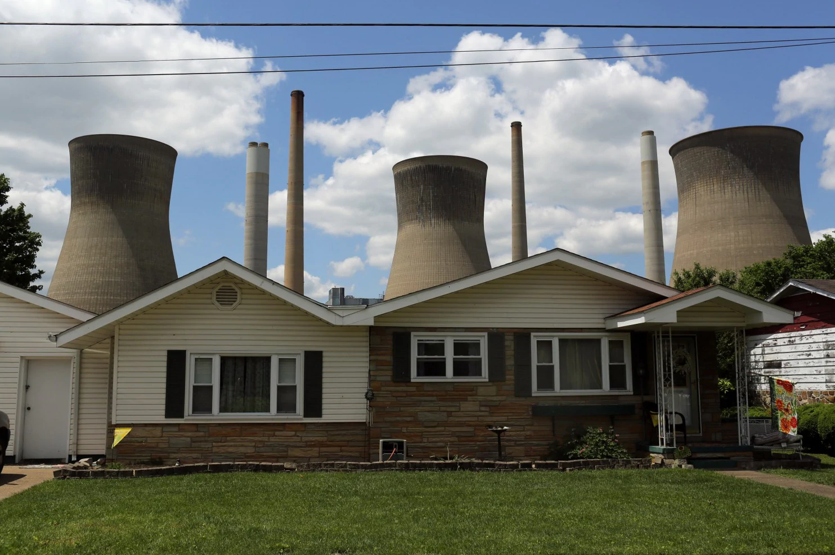
Underserved Population
ARKANSAS DEPARTMENT OF TRANSPORTATION
Notes:
The US DOT and FHWA define the term “underserved population” or “traditionally underserved population” refers to a broad category that includes minority populations and low-income populations but may also include many other demographic categories that face challenges engaging with the transportation process and reaping equitable benefits, such as children, older adults, and persons with disabilities.

Slide 7
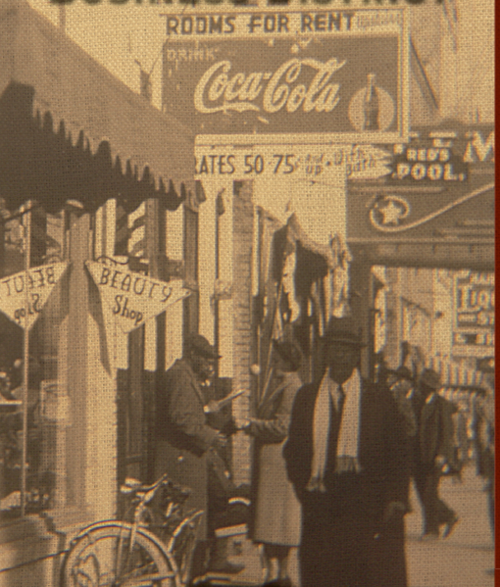
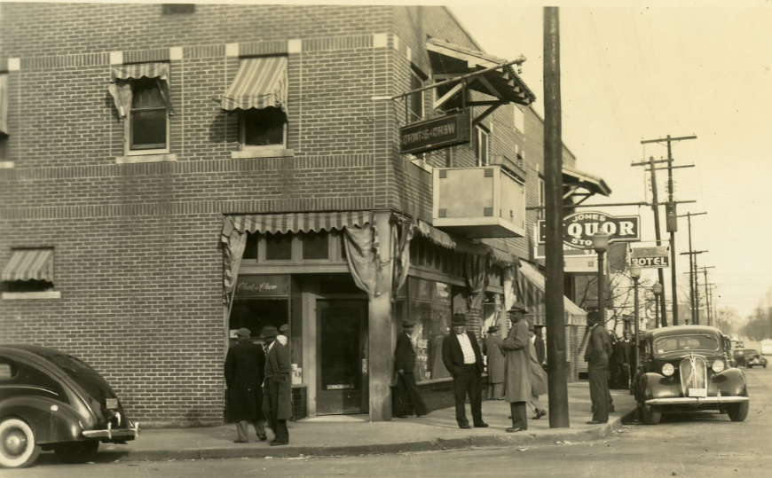
Disproportionately High and Adverse Effect
ARKANSAS DEPARTMENT OF TRANSPORTATION
Notes:
Adverse Effects - means the totality of significant individual or cumulative human health or environmental effects.
Disproportionately high - an effect that:
1) is predominately borne by a minority and/or low-income population; or
2) will be suffered by the minority and/or low-income population and is appreciably more severe or greater in magnitude than the adverse effect that will be suffered by the non minority and/or non low-income population.
Including interrelated social and economic effects, which may include, but are not limited to -
- destruction or disruption of man-made or natural resources;
- destruction or diminished aesthetic values;
- destruction / disruption of community cohesion or economic vitality;
- destruction / disruption of public / private facilities and services;
- adverse employment effects;
- displacement of persons, businesses, farms, or nonprofit organizations;
- increased traffic congestion, isolation, exclusion or separation of minority or low-income individuals within a given community or from the broader community;
- and the denial of, reduction in, or significant delay in the receipt of, benefits of FHWA programs, policies, or activities.
The images are of the former thriving & successful West 9th Street, which was predominantly black business owners
Ninth Street was considered a city within a city. African Americans lived parallel to white society and didn’t need to frequent white businesses because they had everything they needed on 9th Street.
9th Street was intimately connected to other historic black organizations within the surrounding black business district. Philander Smith College, the Phyllis Wheatley YWCA, and the United Friends Hospital were key institutions within that corridor.
This business center was vibrant, bustling, and complete; and it offered a sense of security to the black population.
FHWA Order 6640.23

Slide 8
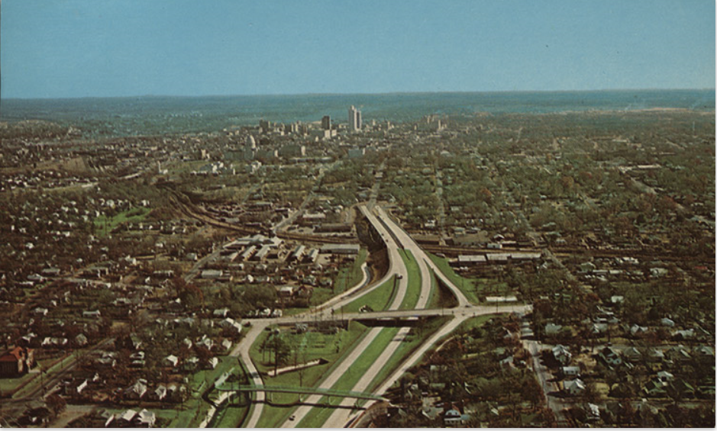
Disproportionately High and Adverse Effect
ARKANSAS DEPARTMENT OF TRANSPORTATION
Notes:
Aerial view of Interstate 630, looking east, when it ended shortly past the Woodrow Street bridge and exit, circa 1970.
As you can see, those that are familiar with I-630, know that Woodrow St. heading west are several miles of interstate. Homes, businesses and communities were completely destroyed for construction.
Community cohesion was completely disrupted
One of the factors that is believed to have contributed to the demise o the vibrant 9th street was the construction of Interstate 630.

Slide 9
Three Fundamental Environmental Justice Principles
To avoid, minimize, or mitigate
To ensure the full and fair participation by all
To prevent the denial of, reduction in, or significant delay in the receipt of benefits
ARKANSAS DEPARTMENT OF TRANSPORTATION
Notes:
As stated, Executive Order 12898 entitled Federal actions to address EJ in minority and low income communities by requiring each federal agency to make achieving EJ part of its mission.
EJ populations are everywhere, yet the construction of highways continue. How is that?
FHWA has identified 3 fundamental principles of EJ.
To avoid, minimize, or mitigate disproportionately high and adverse human health or environmental effects, including social and economic effects, on minority populations and low-income populations.
To ensure the full and fair participation by all potentially affected communities in the transportation decision-making process.
To prevent the denial of, reduction in, or significant delay in the receipt of benefits by minority populations and low-income populations.

Slide 10
Why Address Environmental Justice?
History
Regulation
National Environmental Policy Act (NEPA)
ARKANSAS DEPARTMENT OF TRANSPORTATION

Slide 11
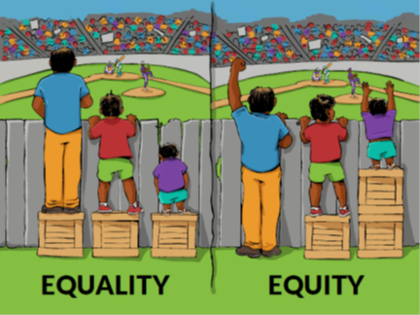
History and Environmental Justice
Transportation equity does not mean
equality in transportation.
ARKANSAS DEPARTMENT OF TRANSPORTATION
Notes:
In the 1st of the two images, all three people have one crate to stand on. In other words, there is “equality”.
While this is helpful for the middle-height person, it is not enough for the shortest and excessive for the tallest.
In contrast, in the second image there is “equity” — each person has the number of crates they need to fully enjoy the game.
In a Nutshell, this image represents environmental justice.
Equity in transportation seeks fairness in mobility and accessibility to meet the needs of all community members.
An equitable transportation plan considers the circumstances impacting a community's mobility and connectivity needs and this information is used to determine the measures needed to develop an equitable transportation network. To attain an equitable transportation network, all components of Title VI, EJ, and Nondiscrimination must be considered.
The roots of Environmental Justice (EJ) (social justice) trace back to the Civil Rights movement.
Historically, communities of color, which were often poor, have served as sites for facilities that have negative environmental impacts.
Such facilities include landfills, industrial plants, and waste treatment facilities…and highway facilities that divided communities.
These facilities near minority and low-income populations helped fuel the EJ movement and served as a means by which to bring attention to and address the inequity of environmental protection within their communities.

Slide 12
Addressing Environmental Justice
Executive Order 12898
  Memorandum of Understanding on Environmental Justice and Executive Order 12898
Department of Transportation Order 5610.2(a)
FHWA Order 6640.23A
Council of Environmental Quality(CEQ)
National Environmental Policy Act (NEPA)
ARKANSAS DEPARTMENT OF TRANSPORTATION
Notes:
In 1994, President Clinton issued Executive Order 12898, directing federal agencies, to the greatest extent practicable, to identify and address disproportionately high and adverse human health or environmental effects of their programs, policies, and activities on minority populations and low-income populations.
In 1997, the Department of Transportation (U.S. DOT) issued an Order to address EJ in minority populations and low-income populations to summarize and expand upon the requirements of Executive Order 12898 on EJ.
The FHWA issued its own EJ Order in 1998 (Order 6640.23). U.S. DOT, FHWA, and other modal administrations have since updated the respective orders and continually seek to enhance their efforts to address EJ effects of their programs, policies, and activities.
DOT 5610.2(a) provides actions to address EJ.

Slide 13
Addressing Environmental Justice continued…
Council of Environmental Quality (CEQ)
Consider the composition of the affected area
Consider the potential for multiple or cumulative exposure
Recognize the interrelated cultural, social, occupational, historical, or economic factors
the effect of any disruption on the community structure; and the nature and degree of impact on the physical and social structure of the community.
Develop effective public participation strategies
Assure meaningful community representation
ARKANSAS DEPARTMENT OF TRANSPORTATION
Notes:
The CEQ provide 6 principles on how environmental justice issues should be identified or addressed.
Agencies should
- Consider the composition of the affected area ... to determine if minority / low-income populations are present and if they will be effected
... and whether or not the effects are disproportionately high and adverse
- Consider the potential for multiple or cumulative exposure to impacts in the affected population and historical patterns of exposure to environmental hazards. (should consider these multiple, or cumulative effects, even if effects are not within the control or subject to the discretion of the agency proposing the action).
- Recognize the interrelated cultural, social, occupational, historical, or economic factors that may amplify the environmental effects of the action …
…. these factors include: physical sensitivity of the community / population to particular impacts; the effect of any disruption on the community structure; and the nature and degree of impact on the physical and social structure of the community.
- Develop effective public participation strategies. - linguistic, cultural, institutional, geographic, and other barriers and incorporate - active outreach to affected groups.
- Assure meaningful community representation in the process. Be aware of the diverse constituencies within any community and endeavor to have complete representation of the community as a whole ...
… early as possible if it is to be meaningful.

Slide 14
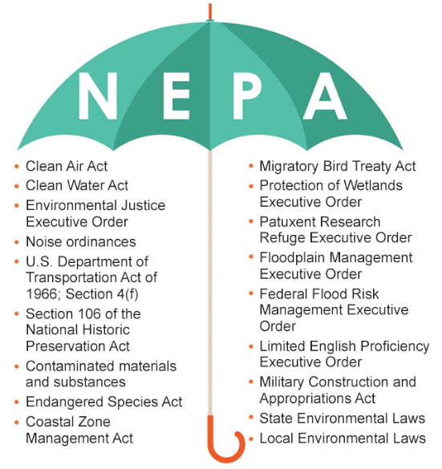
National Environmental Policy Act
ARKANSAS DEPARTMENT OF TRANSPORTATION
Notes:
The purposes of this Act are: To declare a national policy which will encourage productive and enjoyable harmony between man and his environment; to promote efforts which will prevent or eliminate damage to the environment and biosphere and stimulate the health and welfare of man; to enrich the understanding of the ecological systems and natural resources important to the Nation; and to establish a Council on Environmental Quality.
The ARDOT complies with The National Environmental Policy Act (NEPA), which was one of the first laws ever written that establishes the broad national framework for protecting our environment. NEPA's basic policy is to assure that all branches of government give proper consideration to the environment prior to undertaking any major federal action that significantly affects the environment to include any social & economic effects.
The National Environmental Policy Act (NEPA) was signed into law on January 1, 1970. The range of actions covered by NEPA is broad and includes:
making decisions on permit applications,
adopting federal land management actions, and
constructing highways and other publicly-owned facilities.
Agencies also provide opportunities for public review and comment on those evaluations.
NEPA document - In the appropriate section of the NEPA document (EA &EIS), typically the section regarding social and economic impacts, provide demographic information on the general population in the project study area. Social characteristics should include identification of the ethnicity, age, mobility and income level of the population. These data elements, while not all required for an EJ analysis, are important to provide context for understanding area demographics.

Slide 15

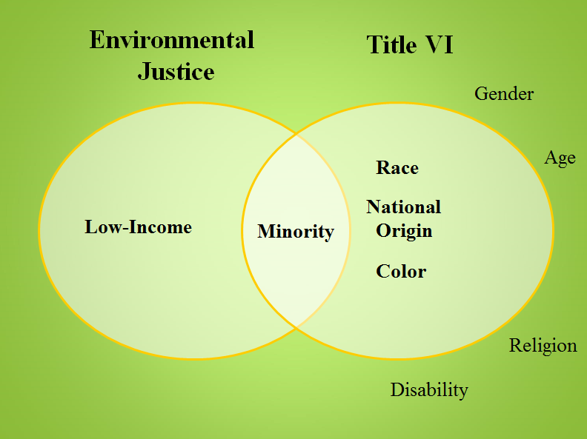
EJ and Title VI
ARKANSAS DEPARTMENT OF TRANSPORTATION
Notes:
It is important to note that when assessing communities for EJ populations, we also examine them for impacts to Title VI populations.
Title VI covers Race, Color and National Origin
These 2 often overlap. Both address nondiscrimination, identify minority populations, are rooted in the constitutional guarantee that all citizens are created equal
both address involvement of affected citizens in the decision making process.
How are EJ and Title VI Different?
Title VI of the Civil Rights Act of 1964 prohibits recipients of federal financial assistance (states, grantees, etc.) from discriminating based on race, color, or national origin in any program or activity.
Executive Order 12898, on the other hand, directs federal agencies to identify and address, as appropriate, disproportionally high adverse impacts on minority populations and low-income populations.

Slide 16
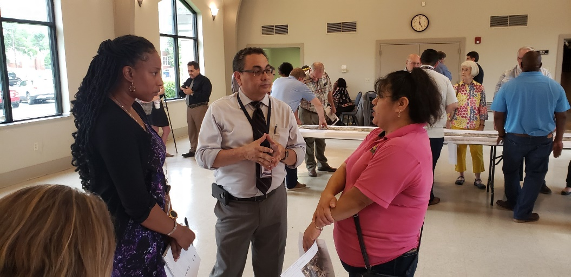
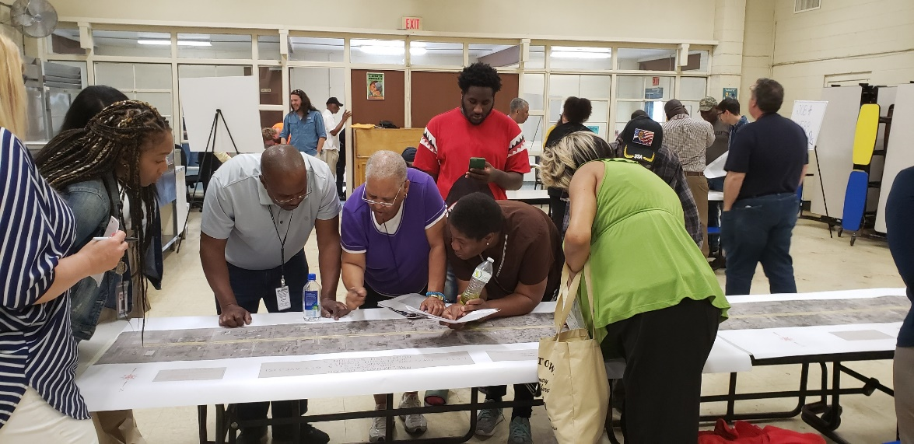
Environmental Justice
ARKANSAS DEPARTMENT OF TRANSPORTATION
Environmental Justice includes Minority and Low Income Populations
EJ mandates a process for inclusive decision making, while Title VI prohibits discrimination.
Notes:
Title VI bears legal requirements while EJ mandates a process for inclusive decision making.
However, a Title VI civil rights complaint may raise environmental justice issues when challenging a recipient's activity. For instance, if a state agency receives funds from EPA to run a clean air program, that state recipient is legally prohibited from discriminating on the basis of race, color or national origin under Title VI when engaging in clean air enforcement activities.

Slide 17
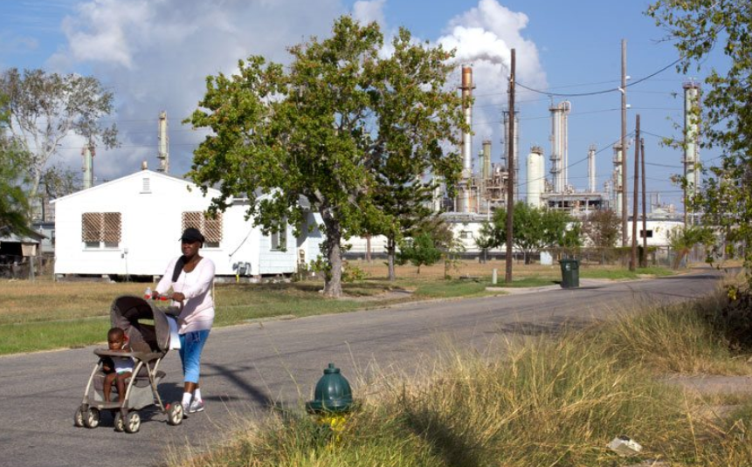
Corpus Christi, TX
ARKANSAS DEPARTMENT OF TRANSPORTATION
Notes:
Corpus Christi’s historic African-American neighborhoods of Hillcrest and Washington-Coles have endured decades of injustice: Redlining and housing segregation, industrial waste and environmental pollution, isolation and neglect from public services.
Texas Department of Transportation and the City of Corpus Christi want to build a new bridge directly through the neighborhood, further separating residents from the rest of the city and exacerbating environmental, health and housing inequalities.

Slide 18
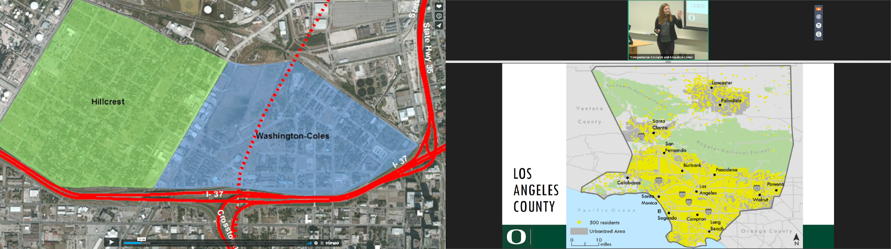
Corpus Christi, TX continued…
ARKANSAS DEPARTMENT OF TRANSPORTATION
Notes:
As planned, the “Red Route” for the new highway would cut Hillcrest off on the east, further segregating it from the rest of Corpus Christi, including its schools, hospitals, grocery stores, and most businesses, and adding increased pollutants like benzene to the already compromised air and soil of the neighborhood. There are approximately 450 households in Hillcrest, with about half occupied by homeowners and half by renters.
On March 5, 2015, Hillcrest neighborhood residents asked the Office of Civil Rights of the Federal Highway Administration (FHWA) to investigate civil rights violations by the Texas Department of Transportation (TxDOT) in its push to build the highway through their neighborhood. The route chosen by TxDOT promised disastrous consequences for residents of Washington Coles and Hillcrest.
The complaint stated that the Red Route violated Title VI of the Civil Rights Act because it would cause disproportionate harms based on race. While the City of Corpus Christi is approximately 4.3% African American, the affected Washington Coles and Hillcrest neighborhoods are 38% and 31% African American, respectively. If FHWA found that TxDOT’s actions caused disproportionate harm based on race, it could withhold federal funds for the project.
Result: A Voluntary Resolution Agreement was reached which proposed specific Title VI mitigation actions for the U.S. Highway 181 improvements These actions will ensure the affected minority persons in the Northside Community of Corpus Christi, Texas (Hillcrest and Washington-Coles) do not bear disproportionately high and adverse human health or environmental effects as a result of the Project.

Slide 19
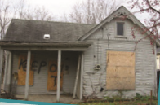
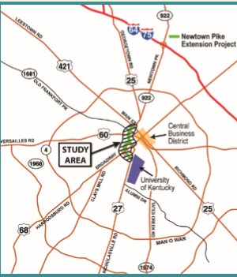
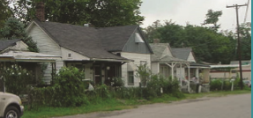
Newtown Pike Extension (KY)
ARKANSAS DEPARTMENT OF TRANSPORTATION
Notes:
Another example of impacts to an EJ community with mitigation efforts is the Newtown Pike Extension in Lexington KY.
The Newtown Pike Extension Project was proposed to address transportation needs near downtown Lexington, Kentucky. This project, originally thought of in the 1930’s, had the potential to pose impacts to low-income and minority communities, publicly owned properties, and historic resources, presented challenges to project implementation.
Davis Bottom community first developed in the late 1800s and the neighborhood grew as a community for workers on Lexington’s railway system. While described as one of the lowest income communities in Lexington, it is also considered highly cohesive. Davis Bottom has been impacted by development associated with its proximity to downtown.
The ARDOT staff must be mindful of the history of these communities that we enter when proposing the construction of hwys.
Important to Note the history: When construction of the Lexington Civic Center and associated facilities began in 1974, approximately 145 dwelling units, 50 apartment buildings, and 20 commercial buildings (including a church) were demolished

Slide 20
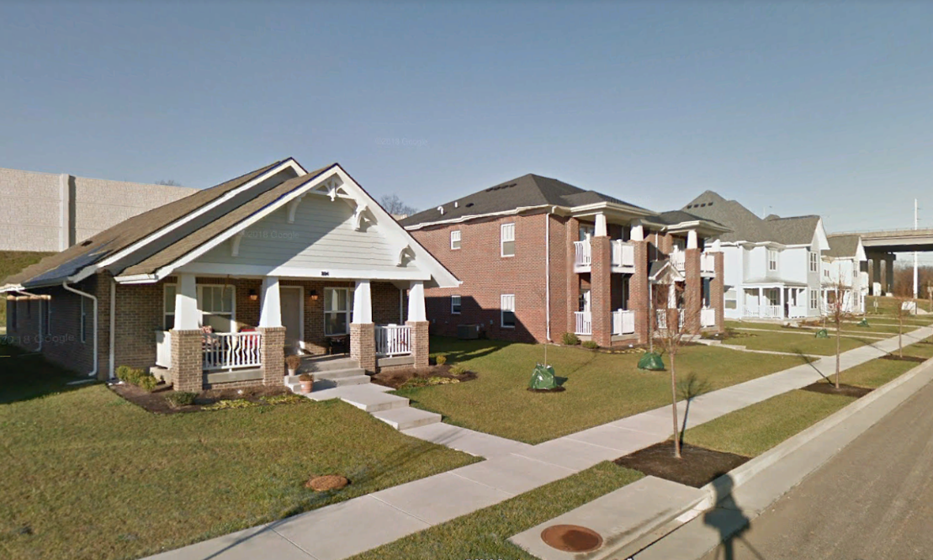
Davis Park (Southend Park
Urban Village)
ARKANSAS DEPARTMENT OF TRANSPORTATION
Notes:
To avoid disruption to community cohesion, mitigate environmental justice impacts, and support the Purpose and Need objective to avoid undue burdens to communities, a variety of mitigation strategies were incorporated into the Newtown Pike Extension Project
The Southend Park Urban Village Plan (now Davis Park) was developed to provide the framework for mitigation of environmental justice impacts. The plan was designed to provide housing that would allow residents of the Davis Bottom community to remain in the area.
25 acres of the Davis Bottom neighborhood would be reconstructed to provide homes, rental units, and new or renovated community facilities.
A Community Land Trust (CLT) was created to implement the plan.
The Key to moving forward with the project was community outreach and engagement. Involving the Davis Bottom community throughout planning, project development, and the design of mitigation strategies was a critical.
I have provided a link to the pamphlet concerning this project.
This pamphlet was developed by the Federal Highway Administration (FHWA) to show how transportation planning, project development, and design can enhance quality of life in a community. The project illustrates the effective implementation of the community impact assessment (CIA) process; collaboration among federal, state, and local agencies; working with affected communities to understand their needs; and integration of quality of life considerations in transportation projects.

Slide 21
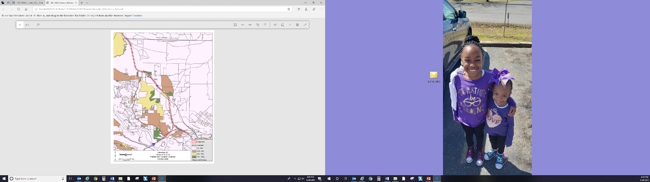

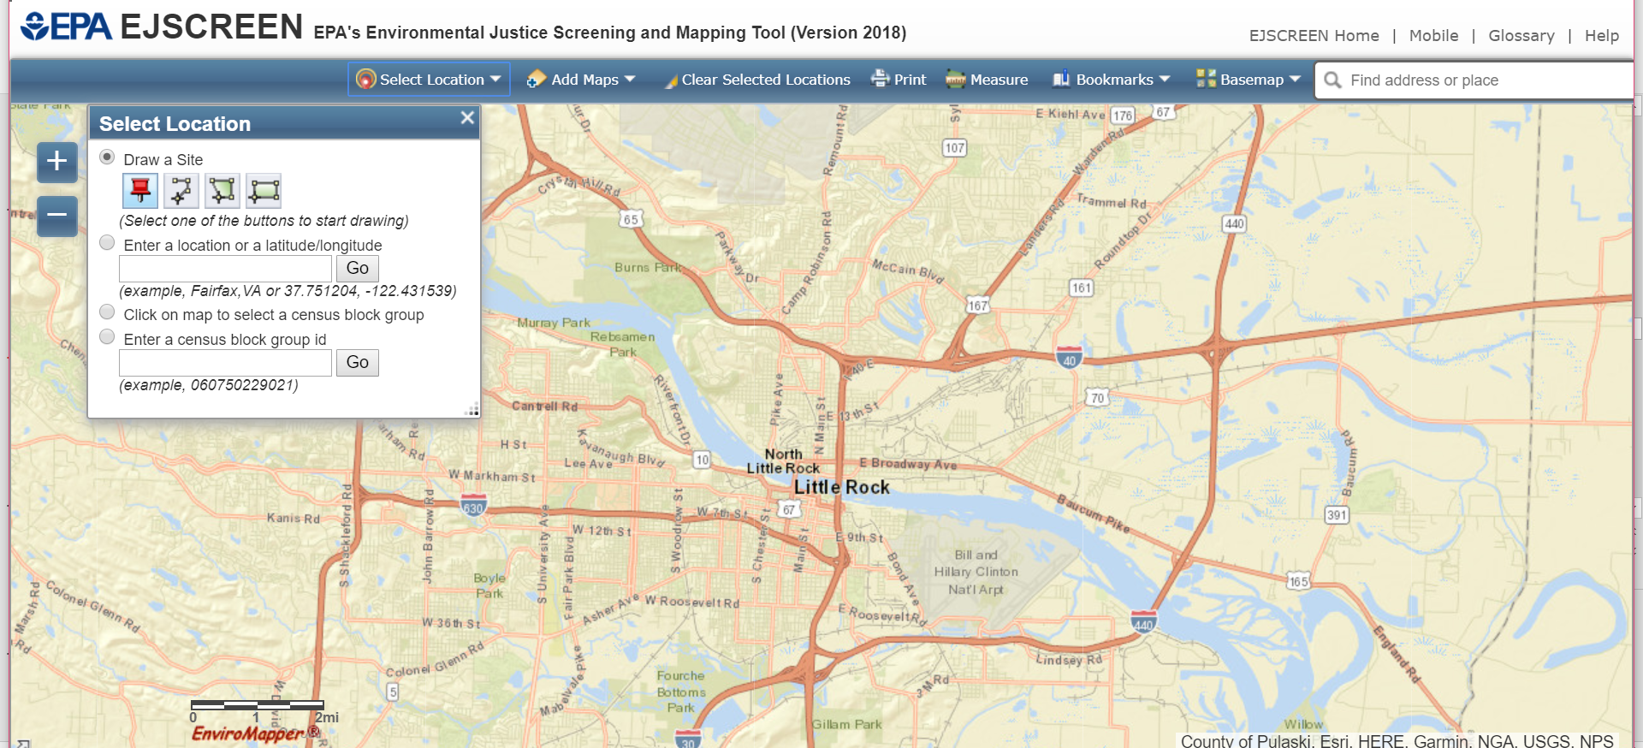
Tools Utilized to Identify EJ Populations
ARKANSAS DEPARTMENT OF TRANSPORTATION
NEPAssist
Notes:
ARDOT utilizes the following tools to ensure EJ compliance with NEPA.
Census data is used to gather Race and ethnicity, disability status, languages spoken at home, veteran status, educational attainment, employment and occupations, income and poverty status, commuting and place of work, housing characteristics.
U. S. Census – American Community Survey
EPA’s EJSCREEN
NEPAssist is a tool that facilitates the environmental review process and project planning in relation to environmental considerations. The web-based application draws environmental data dynamically from EPA Geographic Information System databases and web services and provides immediate screening of environmental assessment indicators for a user-defined area of interest.

Slide 22
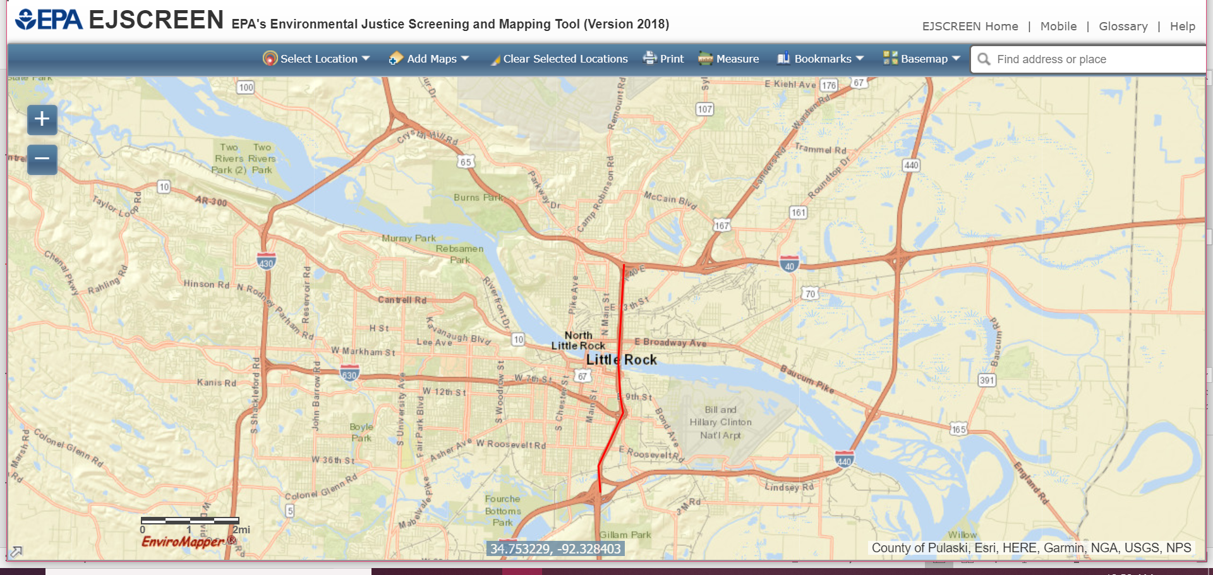
EJScreen
ARKANSAS DEPARTMENT OF TRANSPORTATION
Begin by selecting a geographic area by typing a street name or city into the Launch tool search box.
Once the desired area is found, you have the option of drawing the site…place a line along the highway.
An American Community summary is provided which will include the demographic and environmental information for that area.
Notes:
EPA’s EJSCREEN is an environmental justice mapping and screening tool that provides a nationally consistent dataset and approach for combining environmental and demographic indicators.

Slide 23
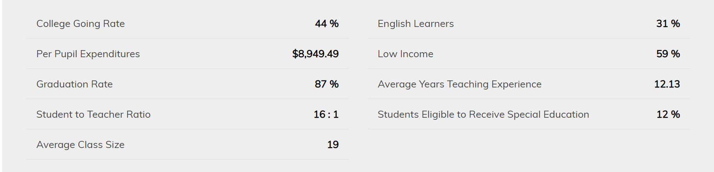
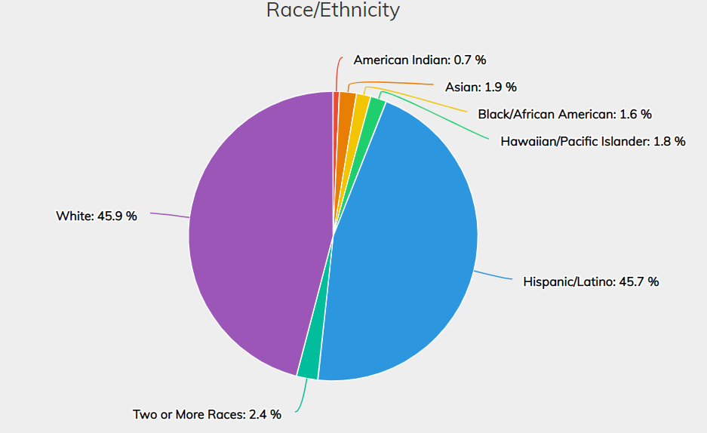
School District Statistics
ARKANSAS DEPARTMENT OF TRANSPORTATION
Notes:
Rogers School District Student Statistics
Why? Schools gather data for multiple reasons
allocation of Title I funding under the No Child Left Behind Act of 2001
Disaggregating data can also valuably inform program implementation and monitoring.
For example, if student survey results show a gender divide in truancy rates, it might be efficient and useful to have gender specific targeted drop-out prevention and attendance programs. This could ensure that resources are spent were they are needed most.
This data can also be used to advocate for specific policy changes, to provide evidence for targeted funding opportunities, and to look for patterns over time and see if similarities or differences are emerging
With this information, does it narrow down to a specific project area. No, but it provides you with a snapshot of the household demographics near the school.
What it does is show us that 59% of the students are considered Low-income
Which could equate to an EJ population near the school

Slide 24

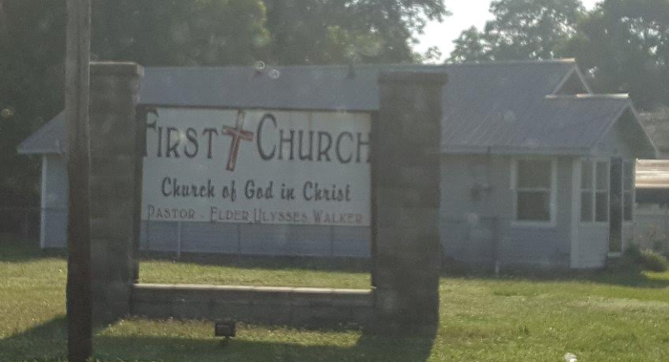
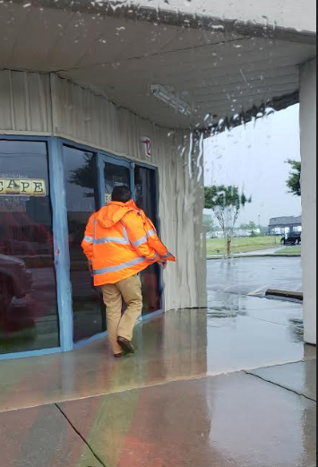
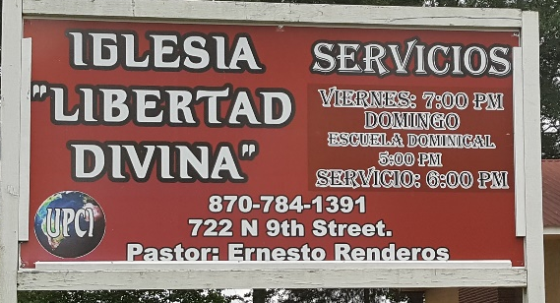

Field Observations
ARKANSAS DEPARTMENT OF TRANSPORTATION
Notes:
One of the best tools that I have found to identify EJ populations that provide accurate results is field observations.
Utilizing the Census, Google Earth are all helpful, however, info may be outdated.
Conduct Community Impact assessments
Physically go to the location, get out of the vehicle and speak with citizens helps build a relationship with stakeholders.

Slide 25

On Learning
ARKANSAS DEPARTMENT OF TRANSPORTATION
What is Environmental Justice?
What is a Minority population?
What are low-income communities?
Notes:
EJ: In short, EJ stems from Executive Order 12898 that forces agencies to take a closer look at the demographics and socioeconomic aspects of communities and populations in areas of proposed impacts.
We are then charged with addressing those impacts by avoiding, minimizing or through mitigation.
Minority a group of people that differ in some way from the majority of the population. In this case, Black, Hispanic, Asian American, American indian
Low-income communities consist of a population that is at or below the poverty guidelines
Minority and Low income people who live in geographic proximity, and, if circumstances warrant, geographically dispersed/transient persons of those groups (such as migrant workers, homeless persons, or Native Americans) who will be similarly affected by a proposed FHWA/DOT program, policy, or activity

Slide 26

Questions?
ARKANSAS DEPARTMENT OF TRANSPORTATION
Notes:
We have time for 2 questions?
I would like to thank everyone for opting to view the Environmental Justice 101 session and I hope the information provided today will be of some assistance to you.

Slide 27


Arkansas Department of Transportation
ARDOT.gov
ARDOT Public Involvement
(501) 569-2563
environmentalpimeetings@ardot.gov
EPA Environmental Justice Learning Center
The Road that Rebuilt a Neighborhood-Newtown Pike Extension Project https://newtownextension.com/wp-content/uploads/2019/06/2015-06_FHWA-Brochure-1.pdf
FHWA Environmental Justice Toolkit https://www.environment.fhwa.dot.gov/env_topics/environmental_justice.aspx
Little Rock as the Nexus of Black Achievement in Arkansas http://mosaictemplarspreservation.org/history_ninth/littlerocknexus.asp
U.S. DOT Environmental Justice Strategy https://www.transportation.gov/transportation-policy/environmental-justice/environmental- justice-strategy
@myARDOT

